Slide 1
Pitch Deck_Hunch Innovations Technology
Introduction of Hunch Innovations: Our company specializes in Industry 4.0 and smart healthcare solutions based on edge computing and vision technologies. In the industrial sector, we reduce equipment costs and improve detection efficiency through advanced image restoration algorithms and modular edge computing, with our first product focusing on defective cable tie detection. In smart healthcare, we offer efficient physiological signal detection systems using remote vision and edge computing technologies for telemedicine. Leveraging research from top universities, we provide customized and efficient technical services.

Slide 2

HUNCH INNOVATIONS × HKU TEA
Our company focuses on Industry 4.0 solutions based on edge computing and vision technology. In the field of artificial intelligence, we reduce equipment costs and improve inspection efficiency through advanced image enhancement algorithms and edge computing. Our first product focuses on defective cable tie detection. In the field of Industry 4.0, we have a mature automated factory and industrial supply chain (including equipment procurement, physical production development, sales and delivery). Our company is based on a top-notch industry-university-research platform, and we provide efficient and intelligent customized services for factories around the world.

Slide 3
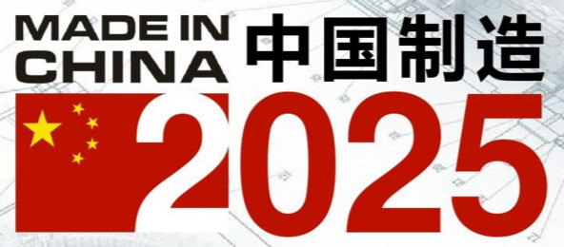
HUNCH INNOVATIONS × HKU TEA
China‘s “13th Five-Year Plan” points out that it will accelerate the construction of a manufacturing power and implement the “Made in China 2025”. Industry is the foundation of the country and the ballast stone of economic development. In 2024, the Decision of the Central Committee of the Communist Party of China on Further Comprehensively Deepening Reform and Promoting Chinese-style Modernization, proposes to improve the system and mechanism for promoting high-quality economic development, and makes clear requirements for accelerating the promotion of new industrialization. In response to those calls, Hunch Innovation Technology(H.I.T) proposes an end-to-end solution for intelligent systems to empower Industry 4.0 artificial intelligence and digital intelligent manufacturing.

Slide 4
For more guidelines
1. Market Analysis
2. Core Technology
3. Product/Service/Solution Design
4. Business Model
5. Development Plan
6. Annual Development Goal
7. Team

Slide 5
1. Market Analysis
Based on extensive research into current industrial vision agency companies (e.g., 东莞市荣旭智能科技, 东莞迅达自动化有限公司, 东莞市佳视自动化科技有限公司) and AIoT companies (e.g., 深圳市力维, Hikvision (海康威视), 深兰科技, Rockchip (瑞芯微)), this project has identified a gap in the market. Large suppliers such as Hikvision have not yet entered the field of customized services for non-standardized products, such as those used in stationery manufacturing, food, and electronic product packaging.
Meanwhile, smaller agencies lack the ability to reduce the cost of supplier hardware and platform usage.

Slide 6
1. Market Analysis
1. Market feasibility analysis According to the survey, large enterprises (such as Hikvision(海康威视), Rockchip (瑞芯微)), ) are not involved in the customization of non-standardized products( Hunch Innovatio can solve it by matured Industry Supply Chain). The services provided by small agents are costly and inadequate. To this end, this project relies on top universities and adopts self-research methods to develop the optimal hardware-algorithm matching for diverse needs through AI algorithm and hardware development (such as image enhancement algorithms, edge computing, burners, etc.). The first generation of product locking cable tie machine defective detection. 2. Competitive feasibility analysis The survey found that large enterprises are reluctant to take the risk of non-standardized development, while small agents lack R&D capabilities. The current market lacks a development platform to support heterogeneous requirements, resulting in suboptimal solutions (e.g., hardware computing power overflow, high cost). 3. Consumer feasibility analysis Southeast Asian companies（Thailand, Indonesia） need to realize the automation and intelligence of production, and have signed cooperation contracts or showed intention. The team has the communication and technical skills to accurately control and deliver requirements. In the scientific community, there is a high demand for high-quality and affordable contactless devices that are highly competitive.

Slide 7
1. Market Analysis
In summary, this project concludes that purchasing the current non-standardized services provided by these agencies entails high costs and product performance risks. To address these problems, this project proposes a development approach that standardizes the selection process. By leveraging the research capabilities of top research universities and adopting a self-developed method, we aim to combine advanced AI algorithms with hardware development experience. This includes using image restoration algorithms to reduce camera costs, modular edge computing to lower hardware computation costs, and flash programming tools to mitigate the need for iterative detection algorithms by the client.
After market research and demand communication, the first generation of this project's services will focus on defective tie detection in packaging machines.

Slide 8
2. Core Technology
1. By utilizing edge computing, the project selects the OK-3588 development board, along with additional modules tailored to client needs. This approach reduces the development cost of overpowered host machines and enhances the operational efficiency of the equipment.
2. Advanced image enhancement algorithms (e.g., SegAD [1], EfficientAD [2]) are employed to lower the development cost associated with high-resolution cameras while improving detection accuracy.
3. Leveraging the advanced research capabilities of and partnering with a development team from the University of Hong Kong and the Hong Kong University of Science and Technology (Guangzhou), this project offers stronger product services and faster iteration speeds compared to smaller agencies.
[1] Baitieva, A., Hurych, D., Besnier, V., & Bernard, O. (2024). Supervised Anomaly Detection for Complex Industrial Images. In Proceedings of the IEEE/CVF Conference on Computer Vision and Pattern Recognition (pp. 17754-17762).
[2] Batzner, K., Heckler, L., & König, R. (2024). Efficientad: Accurate visual anomaly detection at millisecond-level latencies. In Proceedings of the IEEE/CVF Winter Conference on Applications of Computer Vision (pp. 128-138).

Slide 9
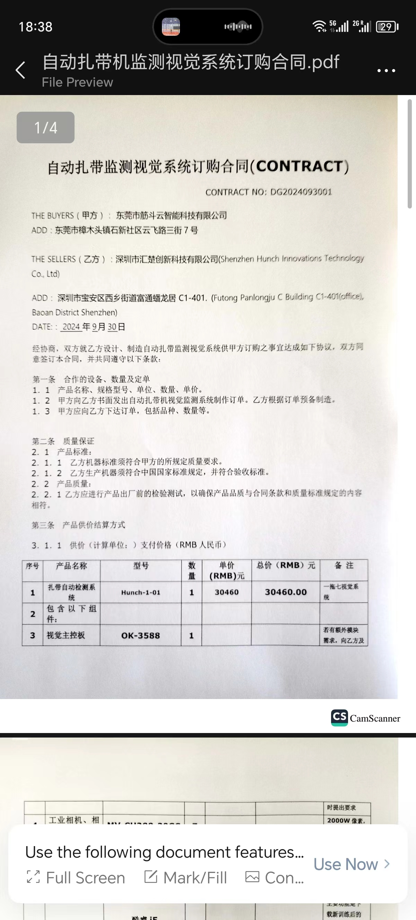
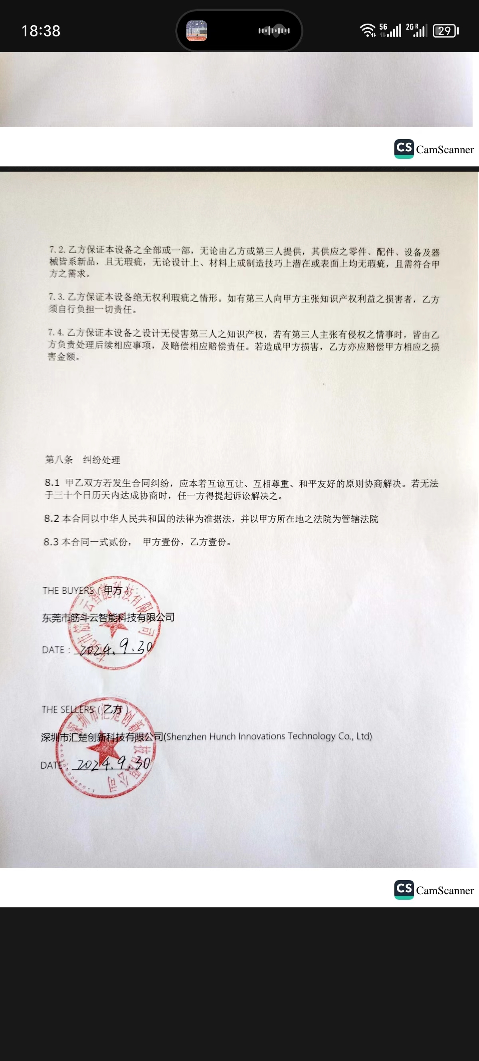
3. Product/Service/Solution Design ( GOT CONTRACT )

Slide 10
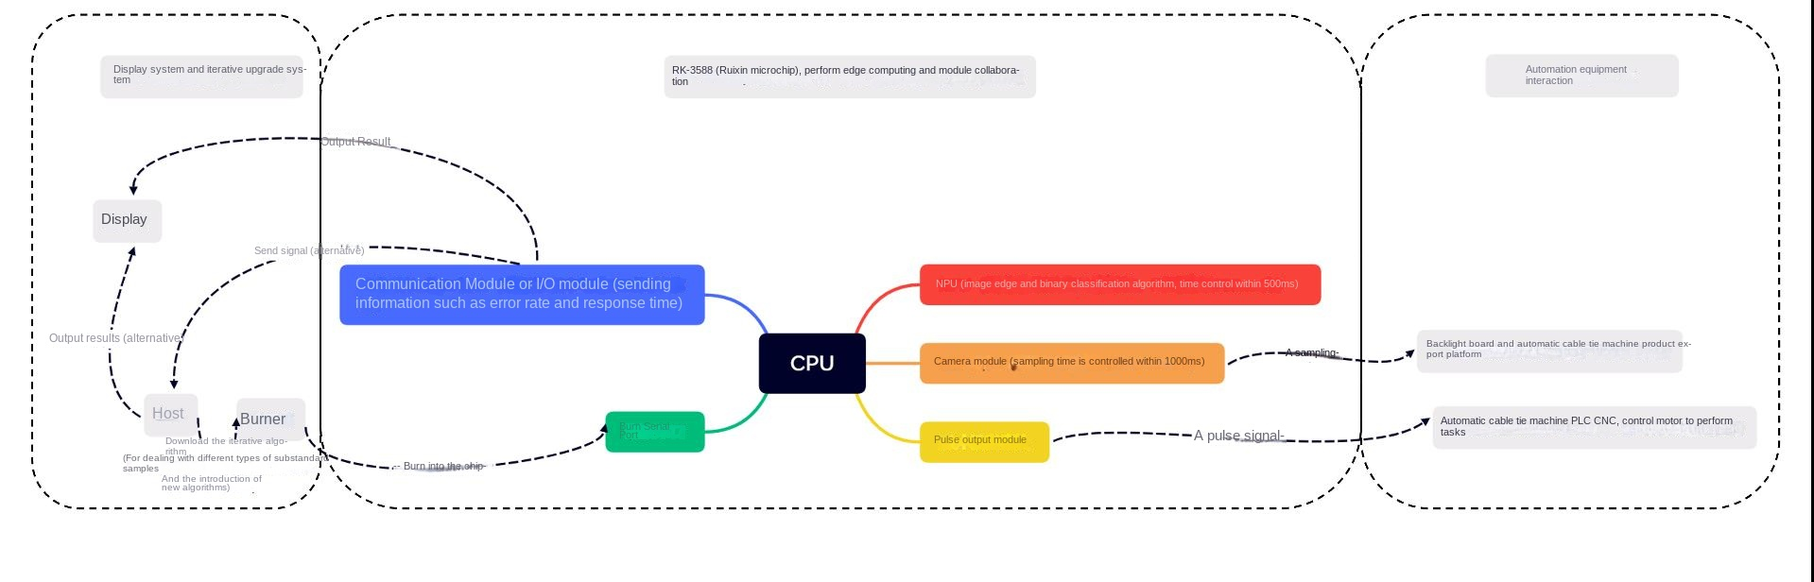
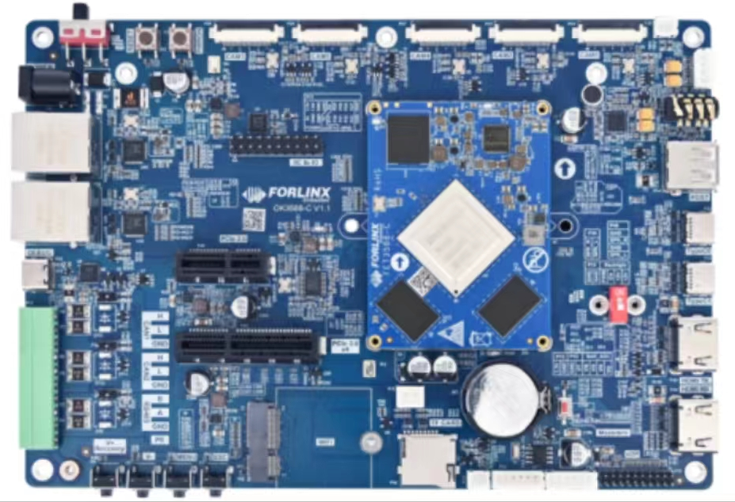
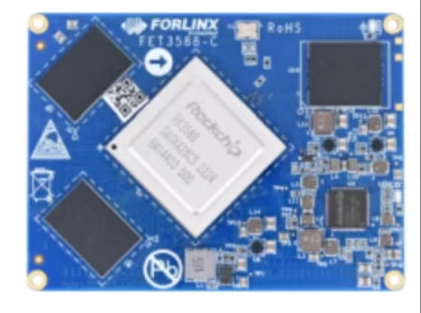
3. Product/Service/Solution Design(Hardware Configuration, Interface and Communication Protocols, Data Flow and System Integration)

Slide 11
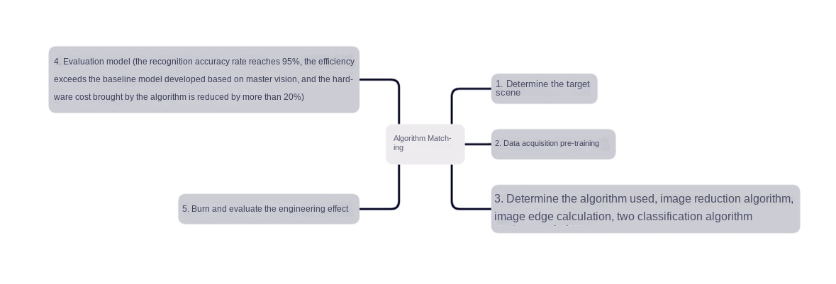
3. Product/Service/Solution Design(Pre-training, Algorithm, Evaluation)

Slide 12
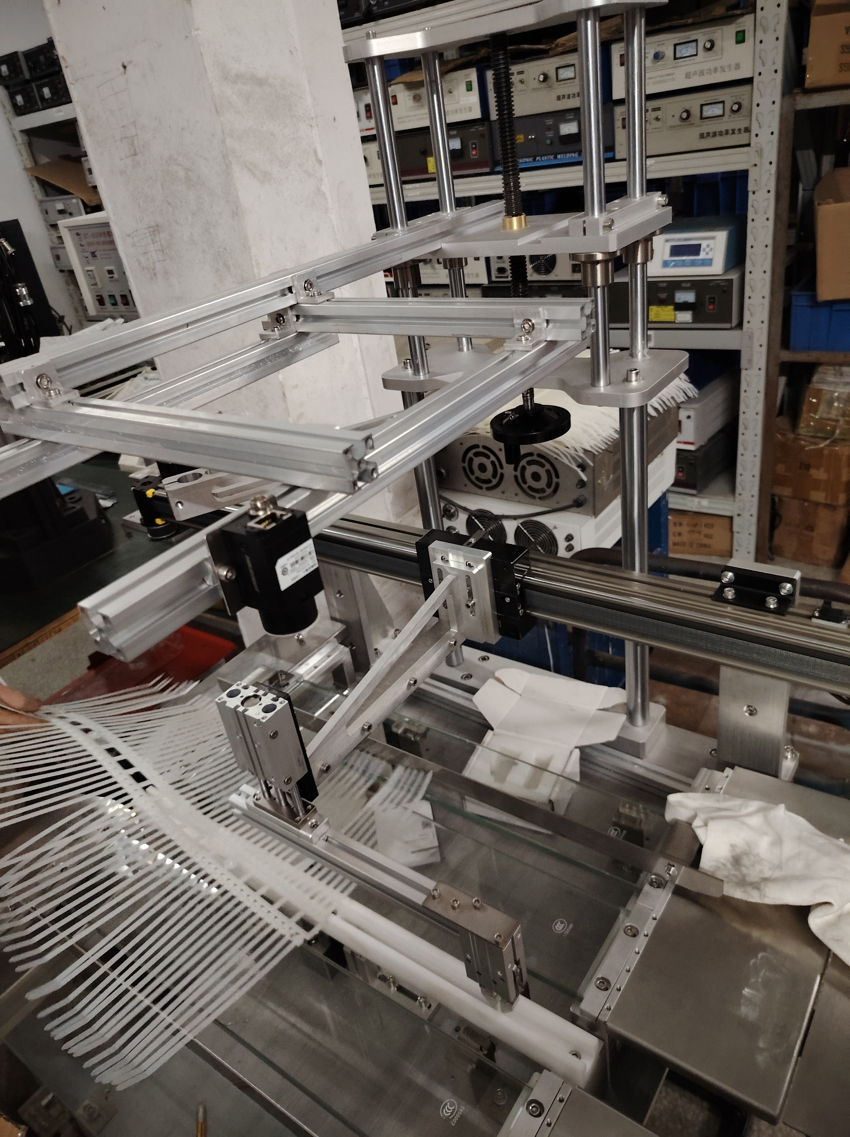
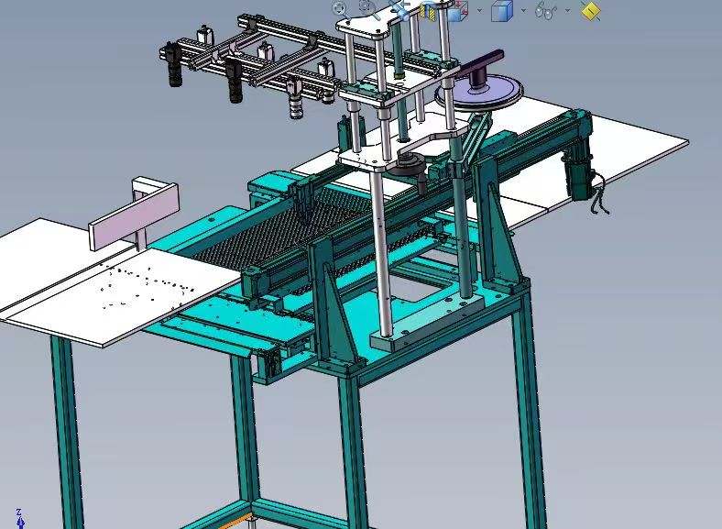
3. Product/Service/Solution Design(Developing Product)
Physical product drawing
Product design drawings
Industrial Cameras & Lenses x6

Slide 13
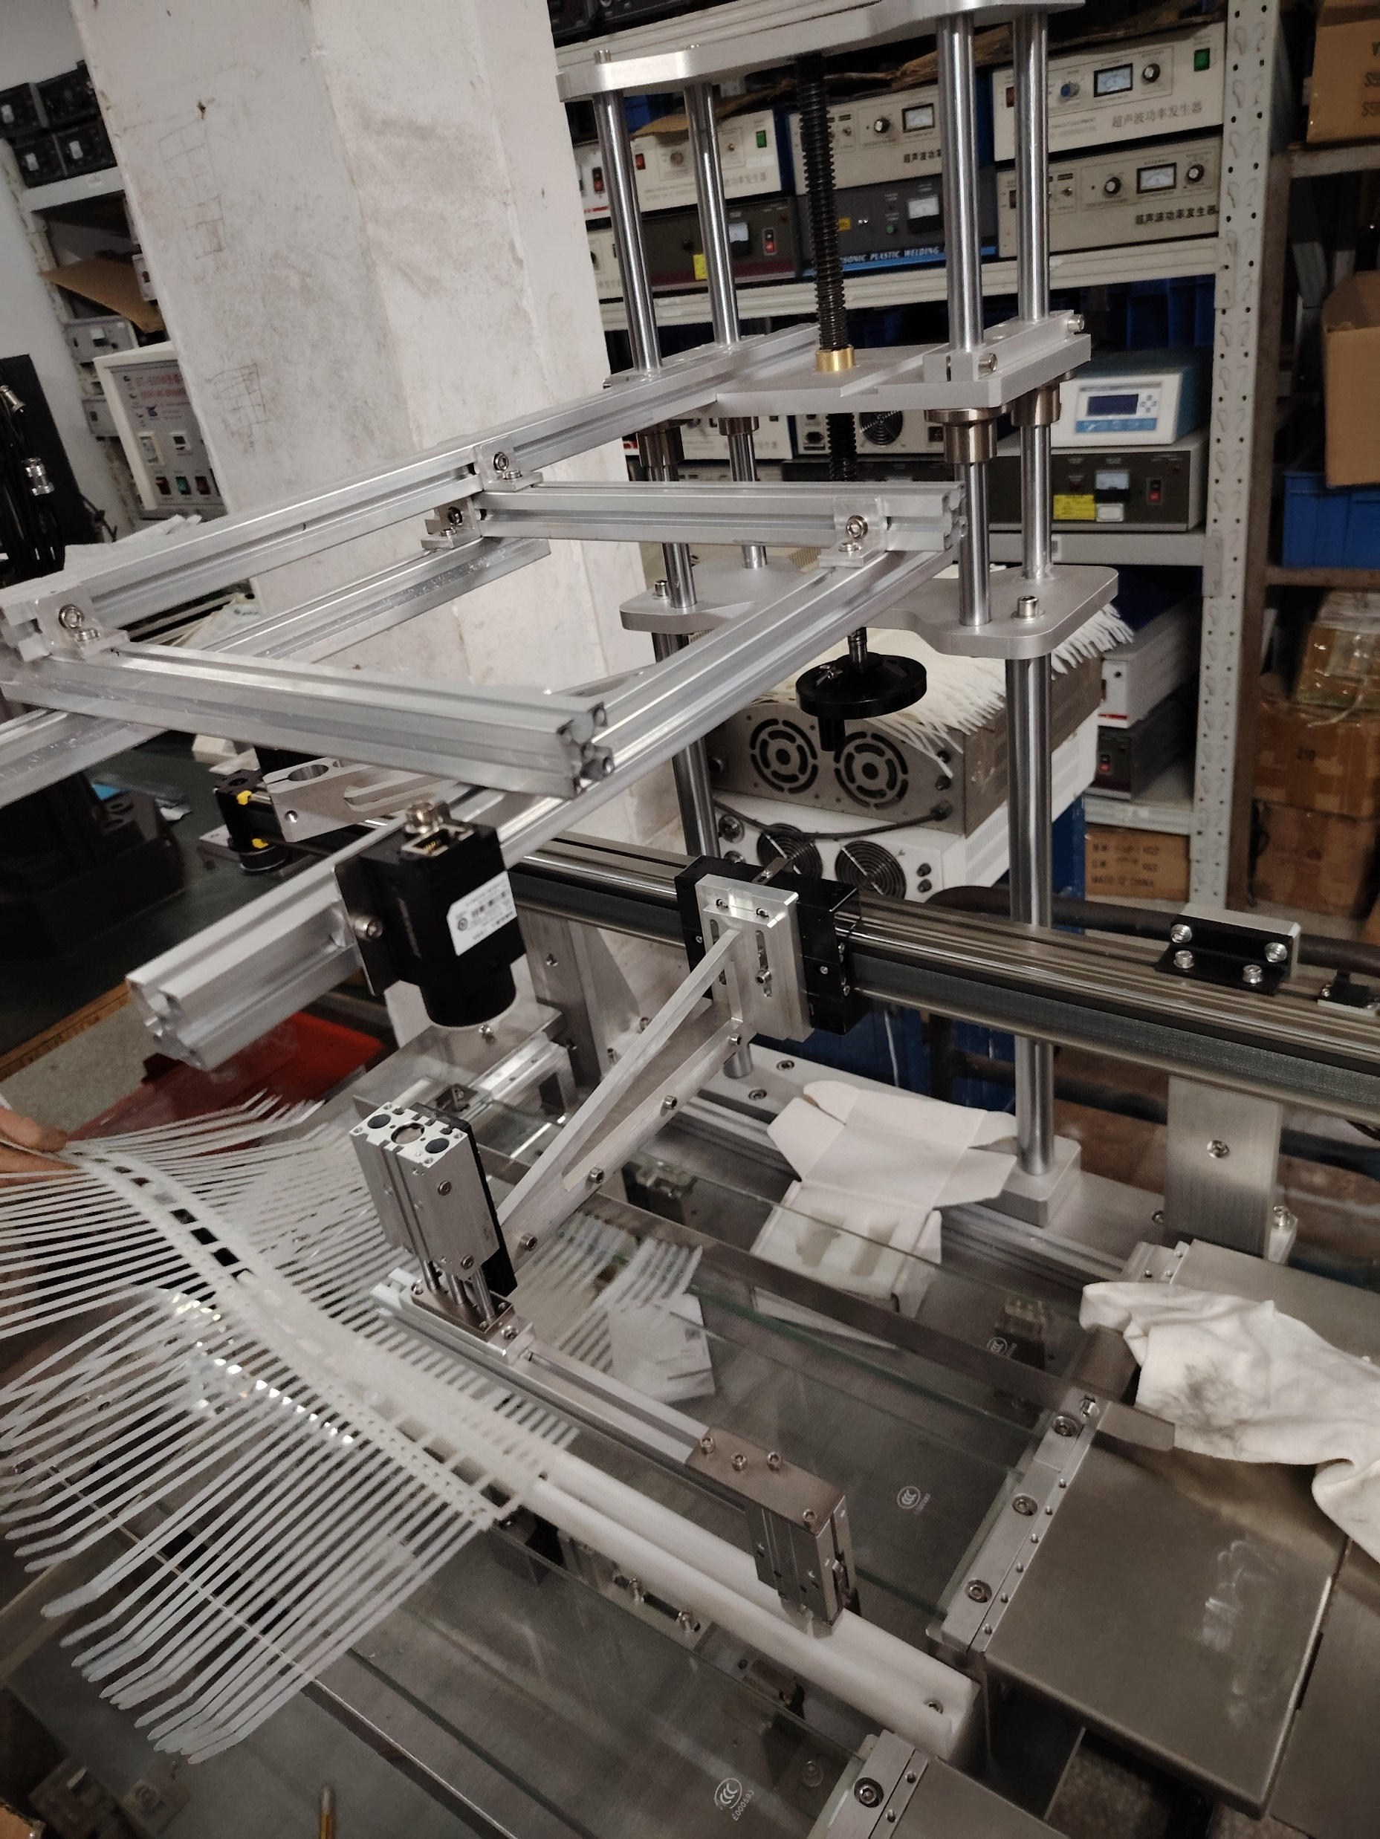
3. Product/Service/Solution Design(Developing Product)
Physical product drawing
Product design drawings
Cylinder drive classification plates

Slide 14
3. Product/Service/Solution Design(Developing Product)
Physical product drawing
Product design drawings
Cylinder drive classification plates

Slide 15
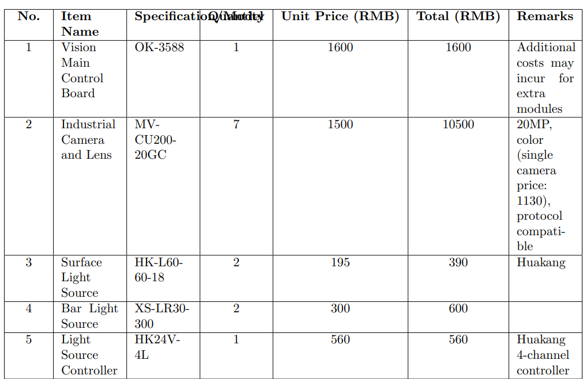
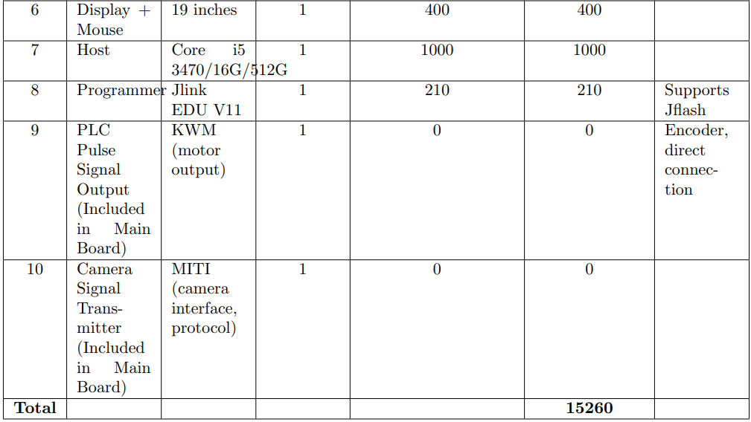
3. Product/Service/Solution Design(Cost of Hardware)

Slide 16
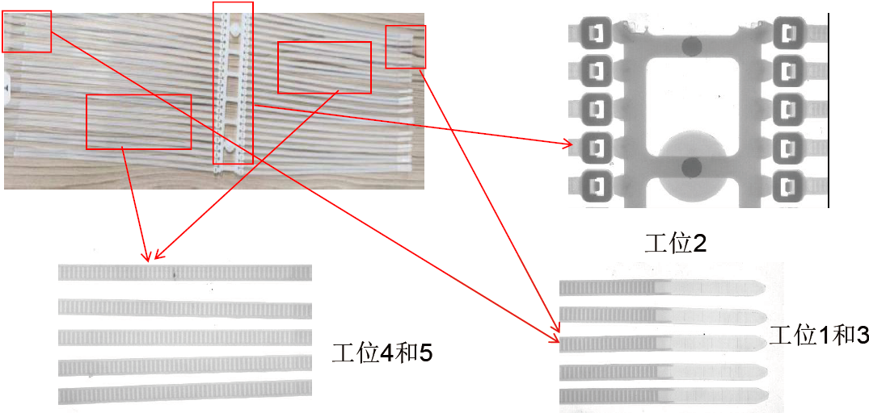
3. Solution Design
Multi-camera joint recognition

Slide 17
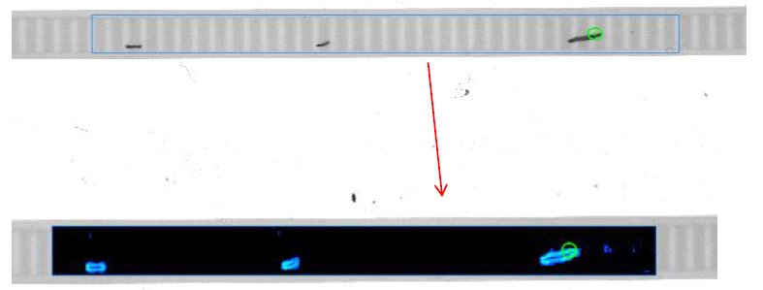
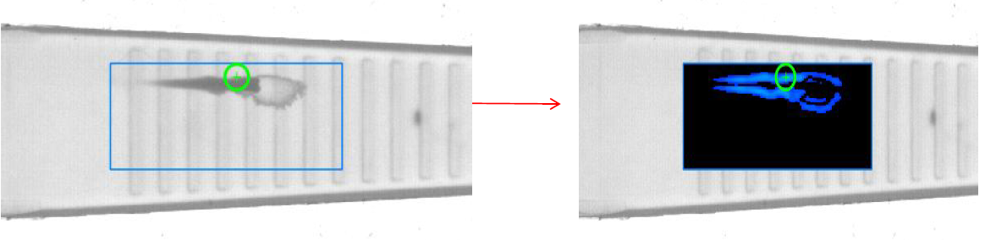
3. Solution Design
1.The results of edge detection are displayed
2. Product size inspection
OK
NG
3. Product black spot detection
4. Product bubble detection

Slide 18
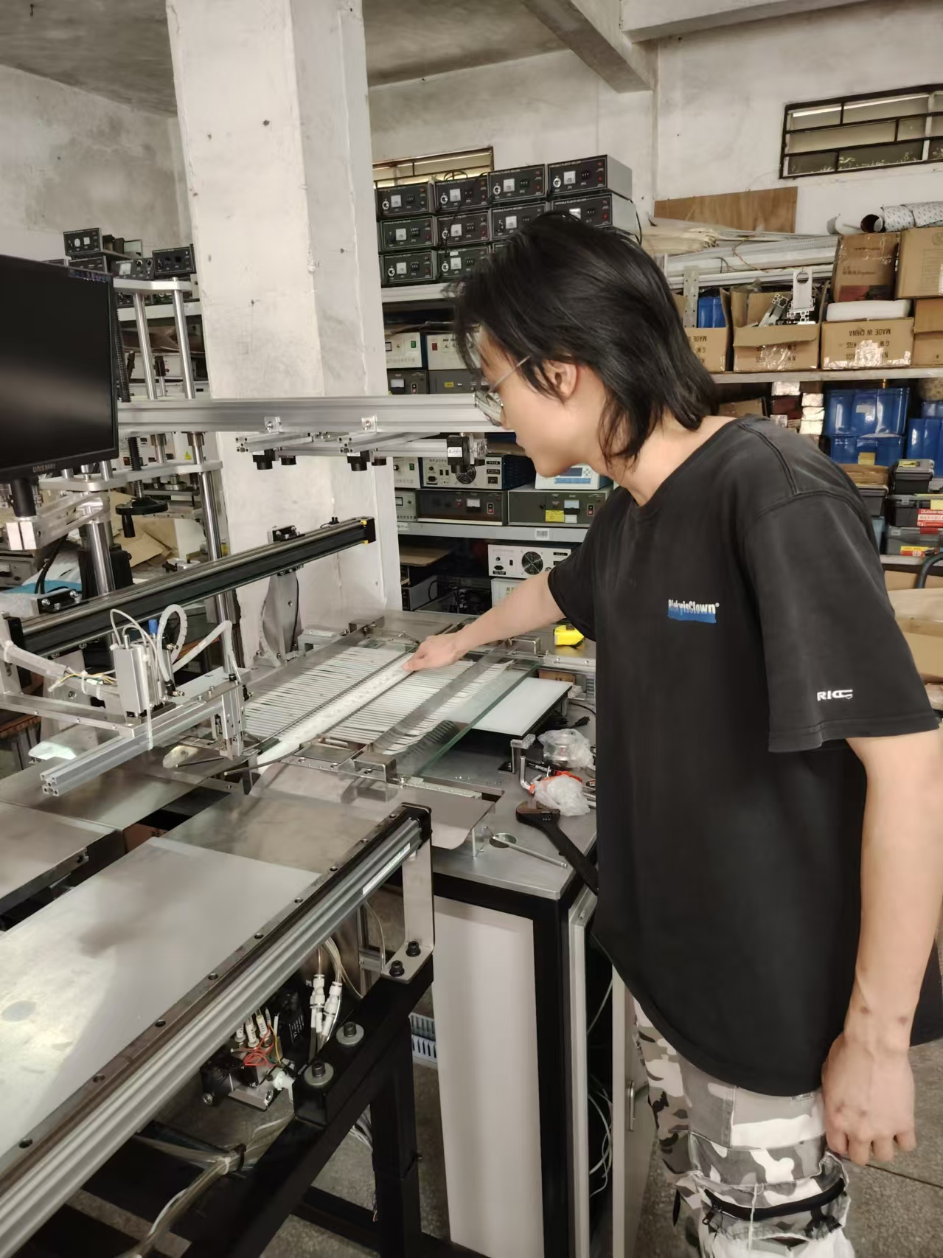
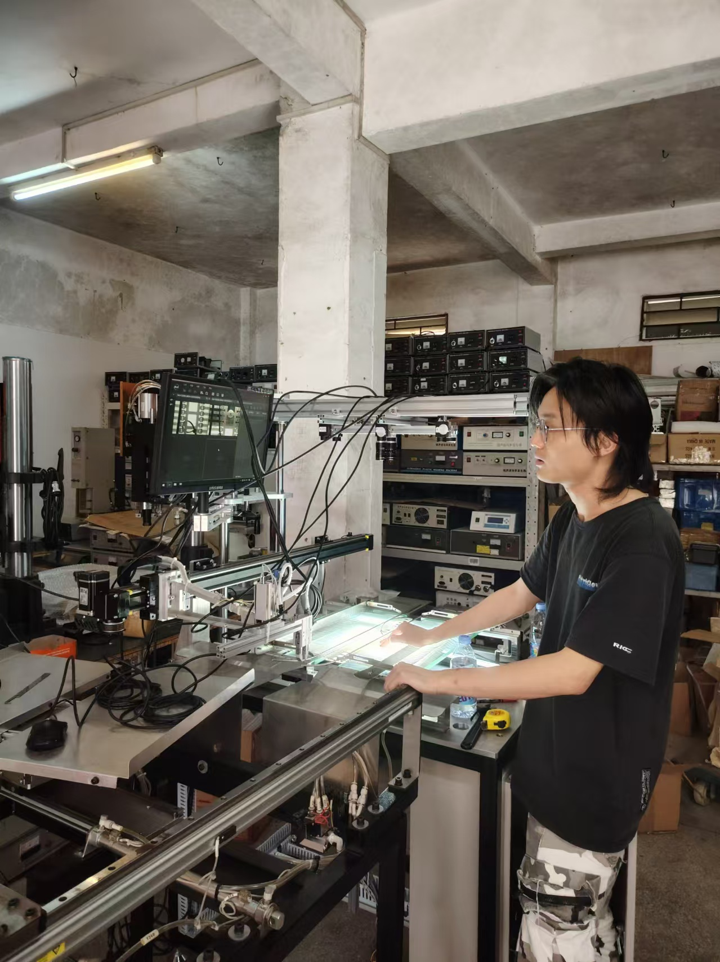
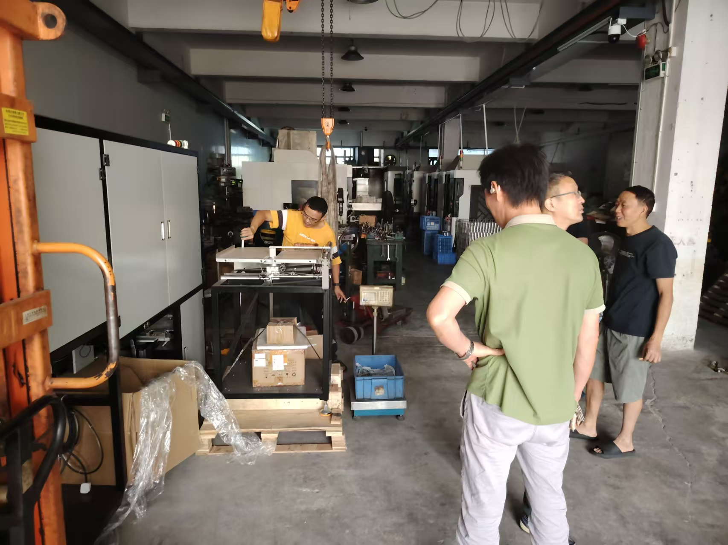
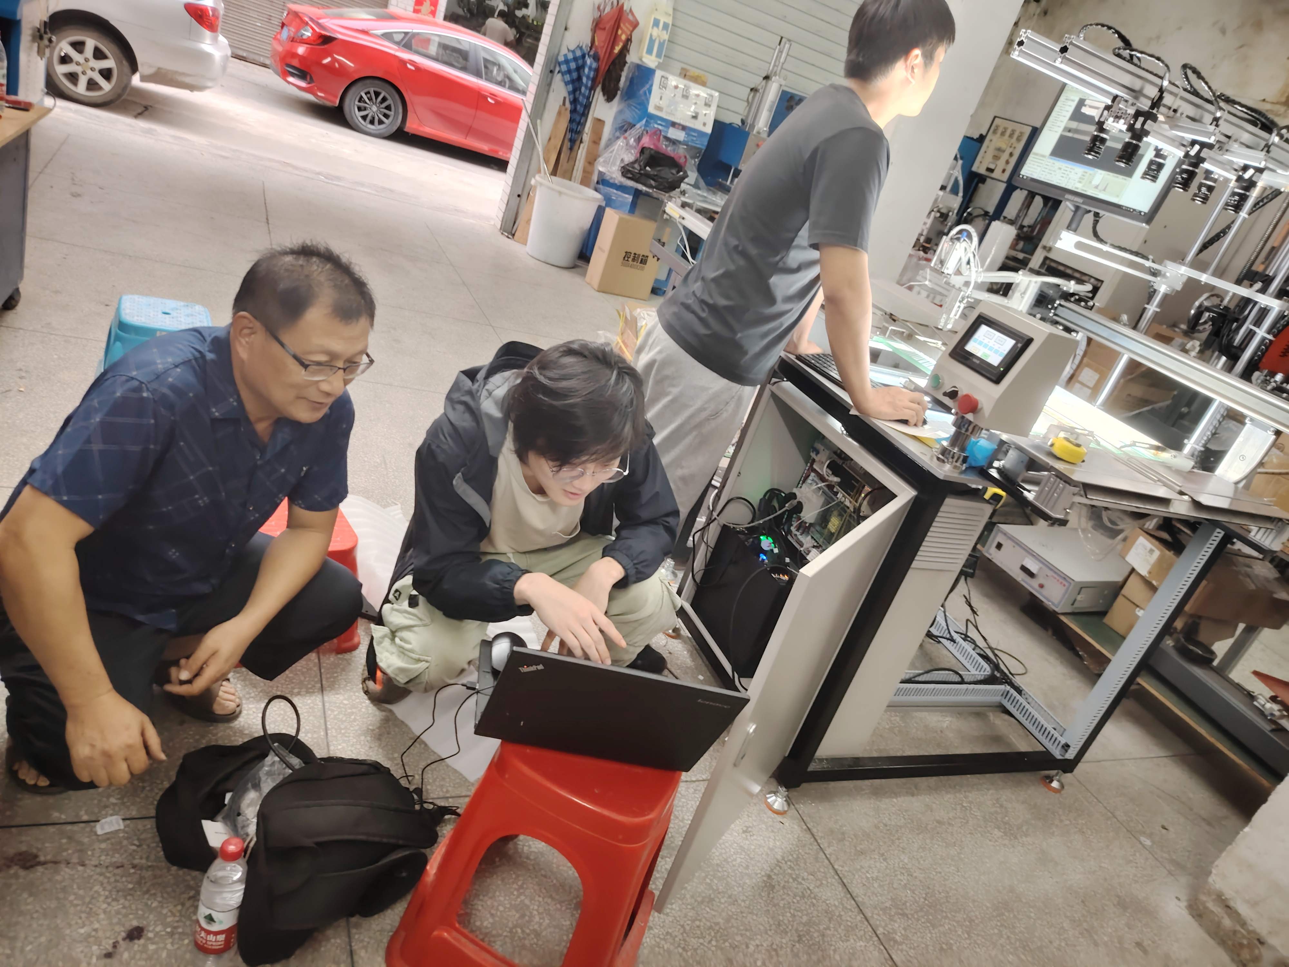
3. Product/Service/Solution Design(Developing Product)
P1. Deploy the entire production machine
P2. Simulate the product entering the inspection area
P3. the effectiveness of the test
P4. Cooperate with the electronic control engineer

Slide 19
3. Product/Service/Solution Design(Delivery Standards& Risks)
Key Points:
Accuracy (95% and above) and response time (≤ 2.5s) are crucial benchmarks.
System stability under real-world conditions, with a packet loss rate of ≤ 1%, is essential.
Combination of supply chain lower the cost of the whole system.
Delivery includes a focus on maintenance, with proper documentation, UI interface design, and algorithm iteration capabilities.
Hardware-software compatibility and after-sales support are critical to mitigate risks

Slide 20
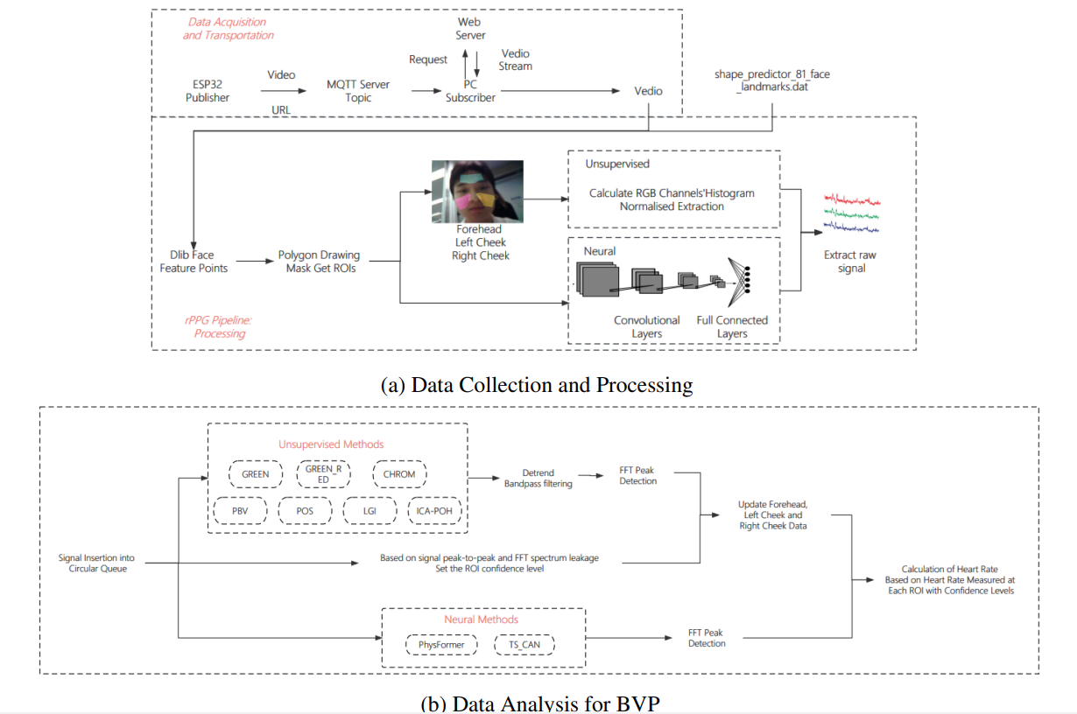
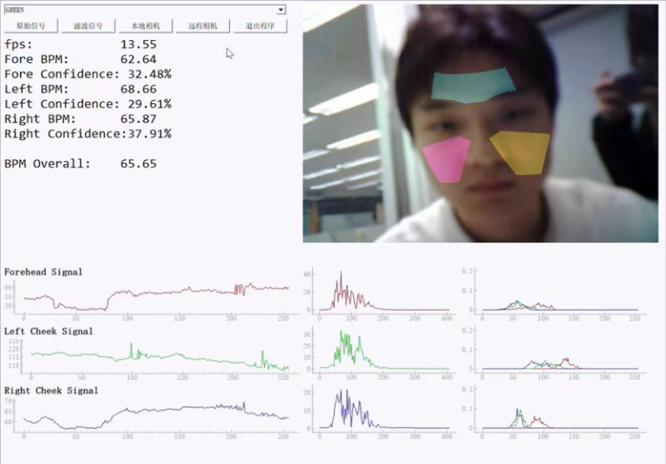
3. Product/Service/Solution Design(Developing Product-rPPG)

Slide 21
4. Business Model
Platform: Cost reduction through industry-academia collaboration. The company adopts an industry-academia-research collaboration model, leveraging top-tier research universities to reduce costs associated with product technical research. This approach fosters the integration between academic research and industrial applications, building a robust commercial ecosystem between enterprises and universities.
Human Resources: Leveraging top talent. The focus is on collaborating with universities to tap into their high-level talent pools. By leveraging the talent attraction capabilities of top platforms, we optimize talent selection and development strategies.
Research & Development: Standardized R&D processes ensure the fusion of advanced technology and efficiency. With a highly skilled development team, the company implements standardized development processes to ensure the combination of advanced technology and high efficiency.
Market: The company capitalizes on its existing broad sales base in the automation field. By offering a reasonable profit distribution, we maximize the potential of the current sales platform to drive growth.

Slide 22
5. Development Plan
End of October: Complete the first and second generation iteration of the cable tie detection device using vision and edge computing.
November: Launch the second non-standard device by optimizing algorithm and development board selection. Aim to sign an order for 39 additional units with the client.
December: Expand into the AI for healthcare sector by developing the first-generation product based on Human factor research, targeting internet companies and hospitals.
Overseas Expansion: Secure overseas orders and expand into Southeast Asia (e.g., Thailand, Vietnam, Indonesia) via the Hong Kong office, focusing on automation. Help developing countries to do rapid industrial upgrading.
Continuous Product Iteration: Utilize market feedback to drive ongoing product improvements. And Leverage data from the development process to optimize the speed of development. Implement generalizable hardware architecture design(based on the matured supply chain); Provide customized algorithm software services for different application scenarios and functional requirements.

Slide 23
6. Annual Development Goal
In one year, the goal is to complete the iteration of the second-generation industrial vision detection product, enabling the company to reach over one million RMB in sales orders (approximately 30 units). The projected profit is 500,000 RMB, with plans to apply for a patent for the detection solution. Based on market research in the South China region, the first-generation product is expected to generate at least 100 orders for non-standardized industrial vision devices. The automation industry has significant demand for vision detection, and the iteration of the product will allow for fast development and low-cost, high-efficiency solutions. The anticipated company profit is 1,500,000 RMB.
Additionally, we plan to launch the first-generation AI for healthcare patent and secure 100 orders from internet companies and mental health platforms. This device, which uses a single camera and costs around 5,000 RMB, will be priced at 120%-150% of the production cost, with an estimated profit of 200,000 RMB. The company will also hire several interns and full-time employees in embedded systems and algorithm development, growing the team to about 10 people.

Slide 24
7. Team
Ximeng Wei(Chief Executive Officer) is a master(EEE department) student at the University of Hong Kong, who brings a wealth of experience in automation development and business operations. This individual has been deeply involved in the development and sales of several overseas automation products and played a key role in a brain-computer interface project targeting international markets at the Shenzhen Institutes of Advanced Technology(SIAT), focusing on hardware integration and automation development.
Edmund Y.Lam(Chief Strategy Officer), is a full-time faculty at the University of Hong Kong, working as Associate Dean (Innovation and Career Development), Graduate School, Associate Head (Research and Innovation), EEE Department, Director of Computer Engineering Program, Director of Imaging Systems Laboratory,
Jiyao Wang(Chief Technology Officer) is a current Ph.D. candidate at the Hong Kong University of Science and Technology (Guangzhou), who possesses extensive expertise in vision AI research.
Jiquan Wei has over 10 years of experience in automation product sales and was previously the annual sales champion for Estun Automation in South China.
Jiaxu Li(Supply Chain Officer & Semiconductor Engineer), an EE graduate master from Nanyang Technological University. He worked as a semiconductor engineer in Singapore Agency for Science, Technology and Research (A*STAR). He is an engineer in Focaltech-Electronics.
Yinjie Zhao(Embedded Engineer), graduated from HKU EEE(telecommunication). He has been involved in the development of the embedded part of rPPG projects.
In addition, the team includes several interns who are responsible for 1.user interface design, 2.embedded module development, 3.functional implementation, and 4.algorithm integration. These interns work on the debugging and implementation of algorithms, ensuring compatibility with the overall system.

